Slide 1

Flights & passengers

Slide 2
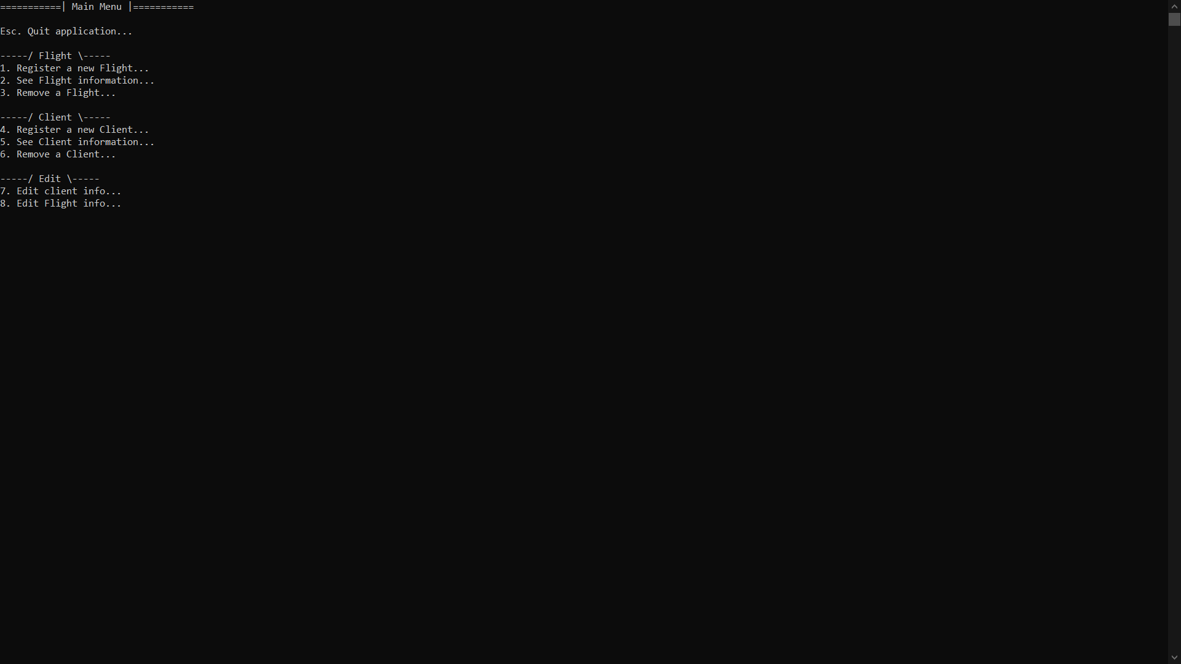
What is Flights and Passengers?
Flights and Passengers is a way to register and book a flight the easiest way. Entering, removing and editing information about a flight or a client is as simple as possible. With just 2 click of a button you can completely edit the flight or client information.

Slide 3
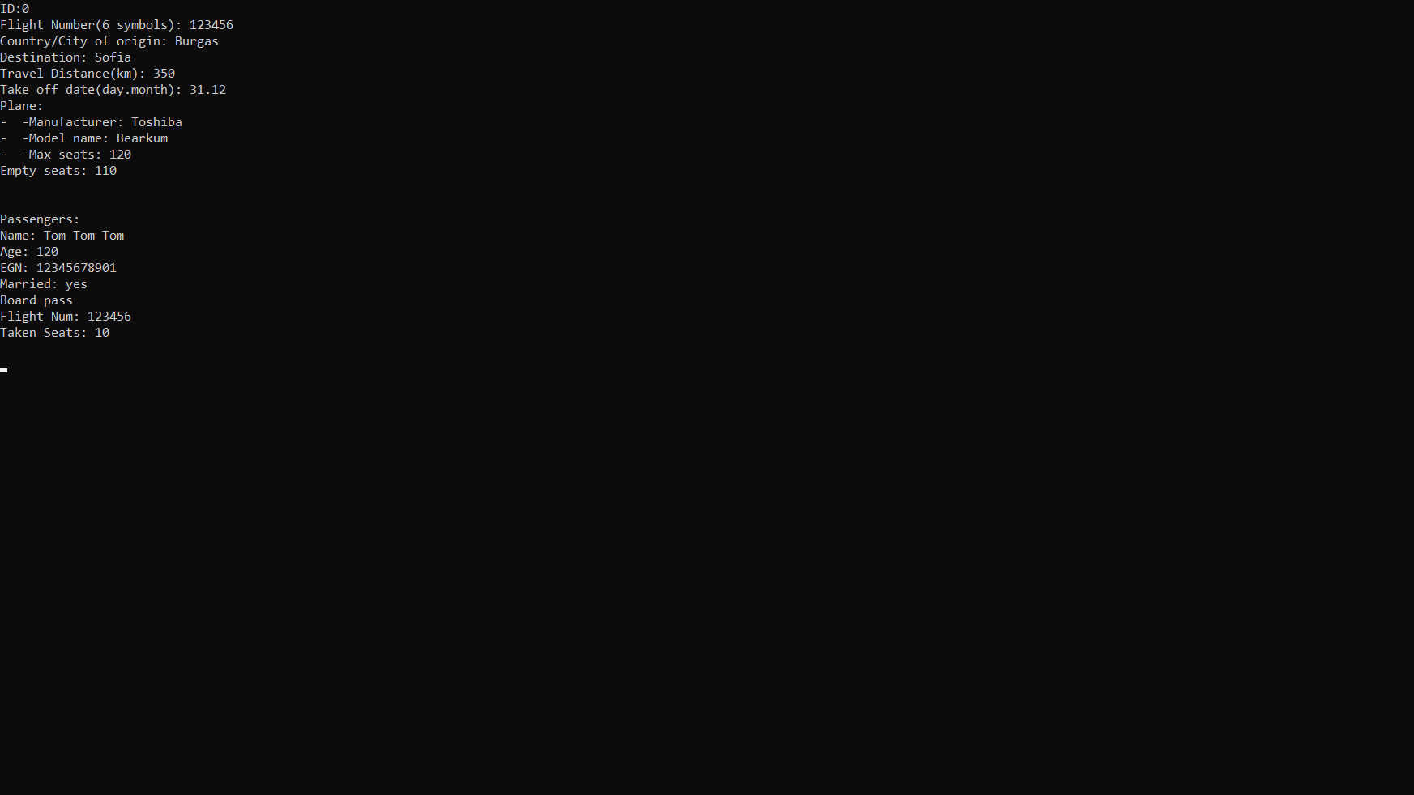
How does it work?
When the program is being started the first thing that users see is the Main Menu. In the menu you can: exit the application, register or remove a flight, see flight information, register & remove a client, see client information, edit client or flight information.
Everything you need to know about a specific flight or client is in one place. A user can see the flight number, Country/city of origin, flight destination, travel distance, take off date. There is also a plane information included like: manufacturer, model name, max seats and empty seats. All these variables can be easily edited using the edit flight option in the main menu.

Slide 4
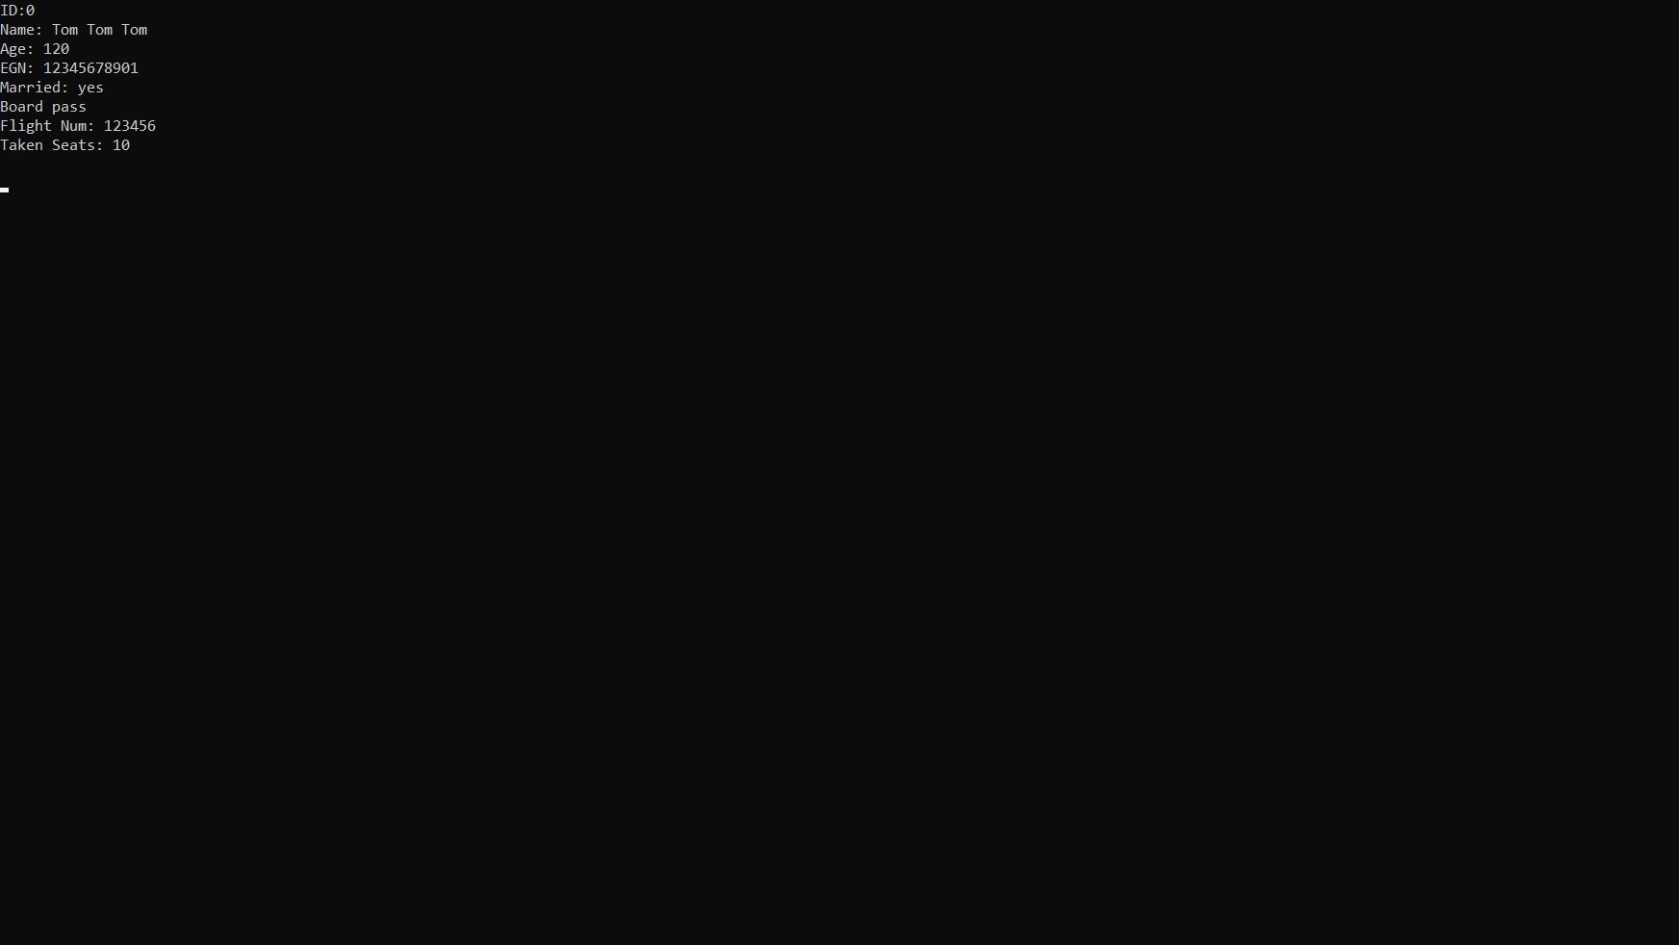
Client Information
Seeing the client information a user can change it by going to the main menu and choosing the "Edit Client Information" option. Information like name, age, EGN, marriage and board pass is shown when registering or editing a client.

Slide 5
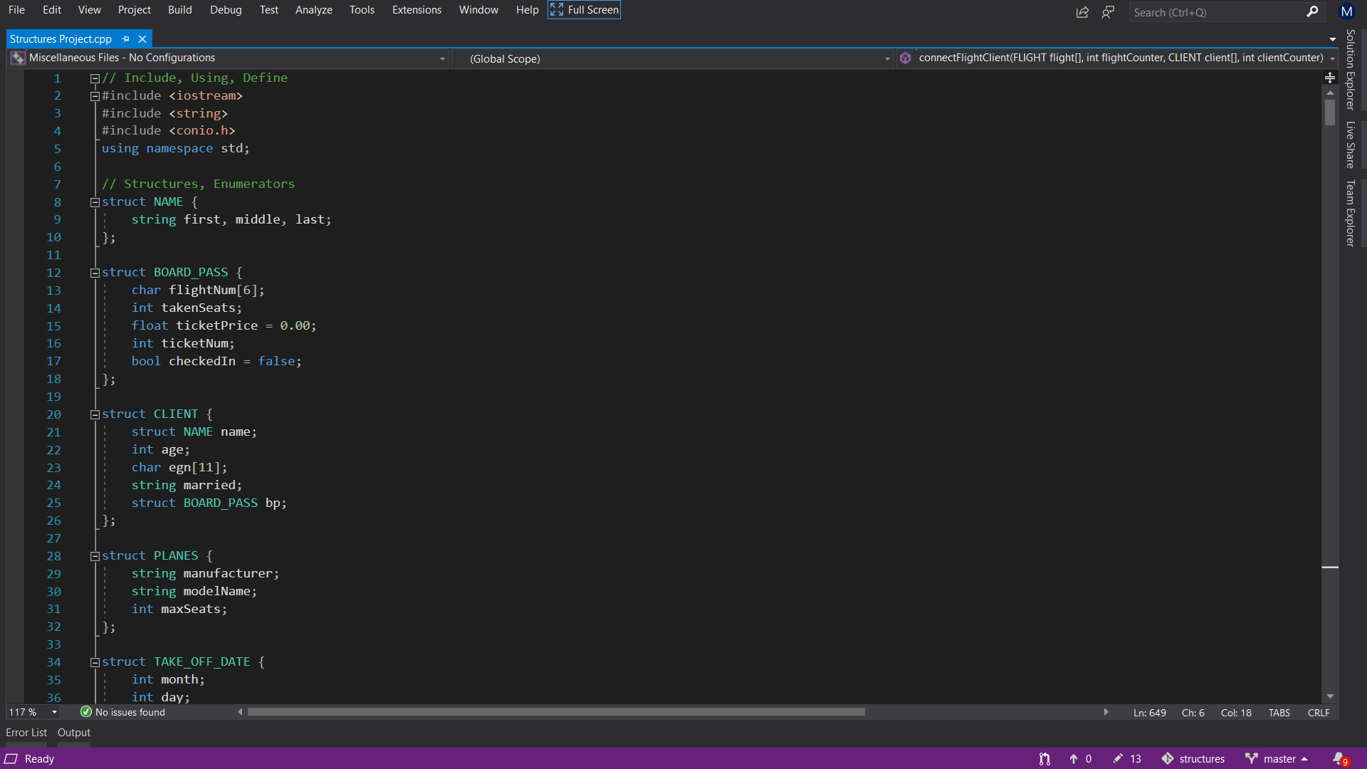
How was the program made?
Flights and Passengers is a C++ program with over 780 lines of code. It includes 3 libraries and multiple functions with different objectives.

Slide 6
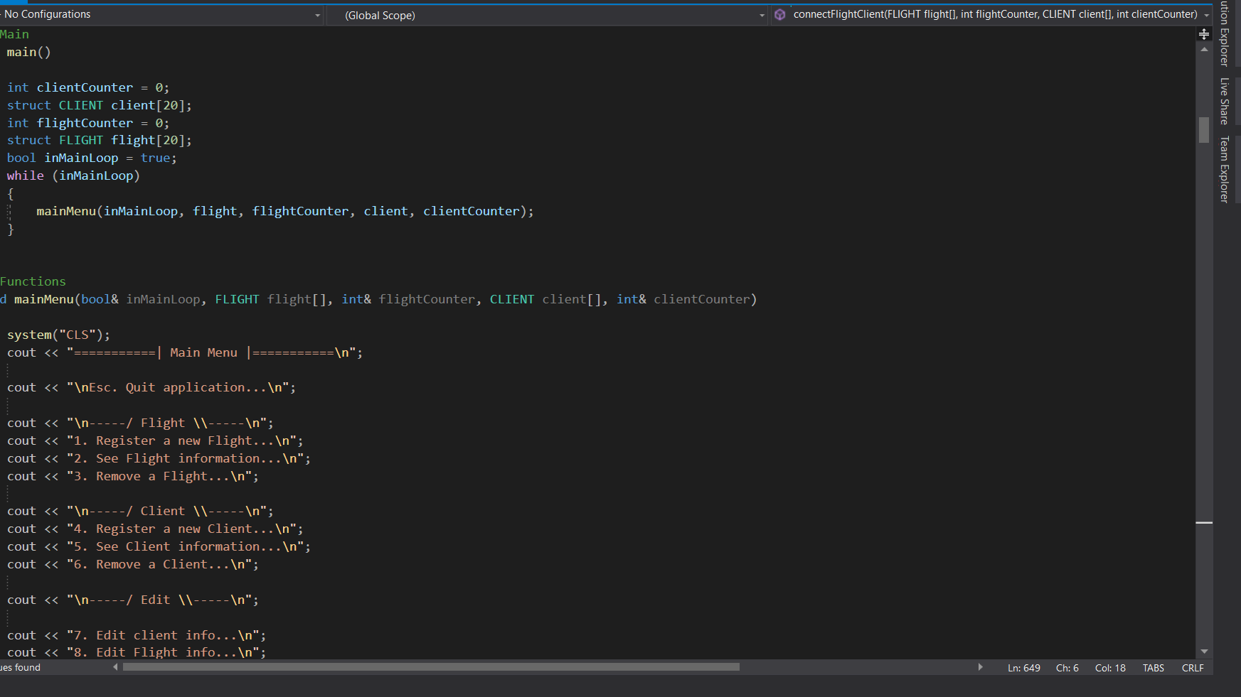
Main Menu
The main menu layout provides easy navigation through the program.

Slide 7
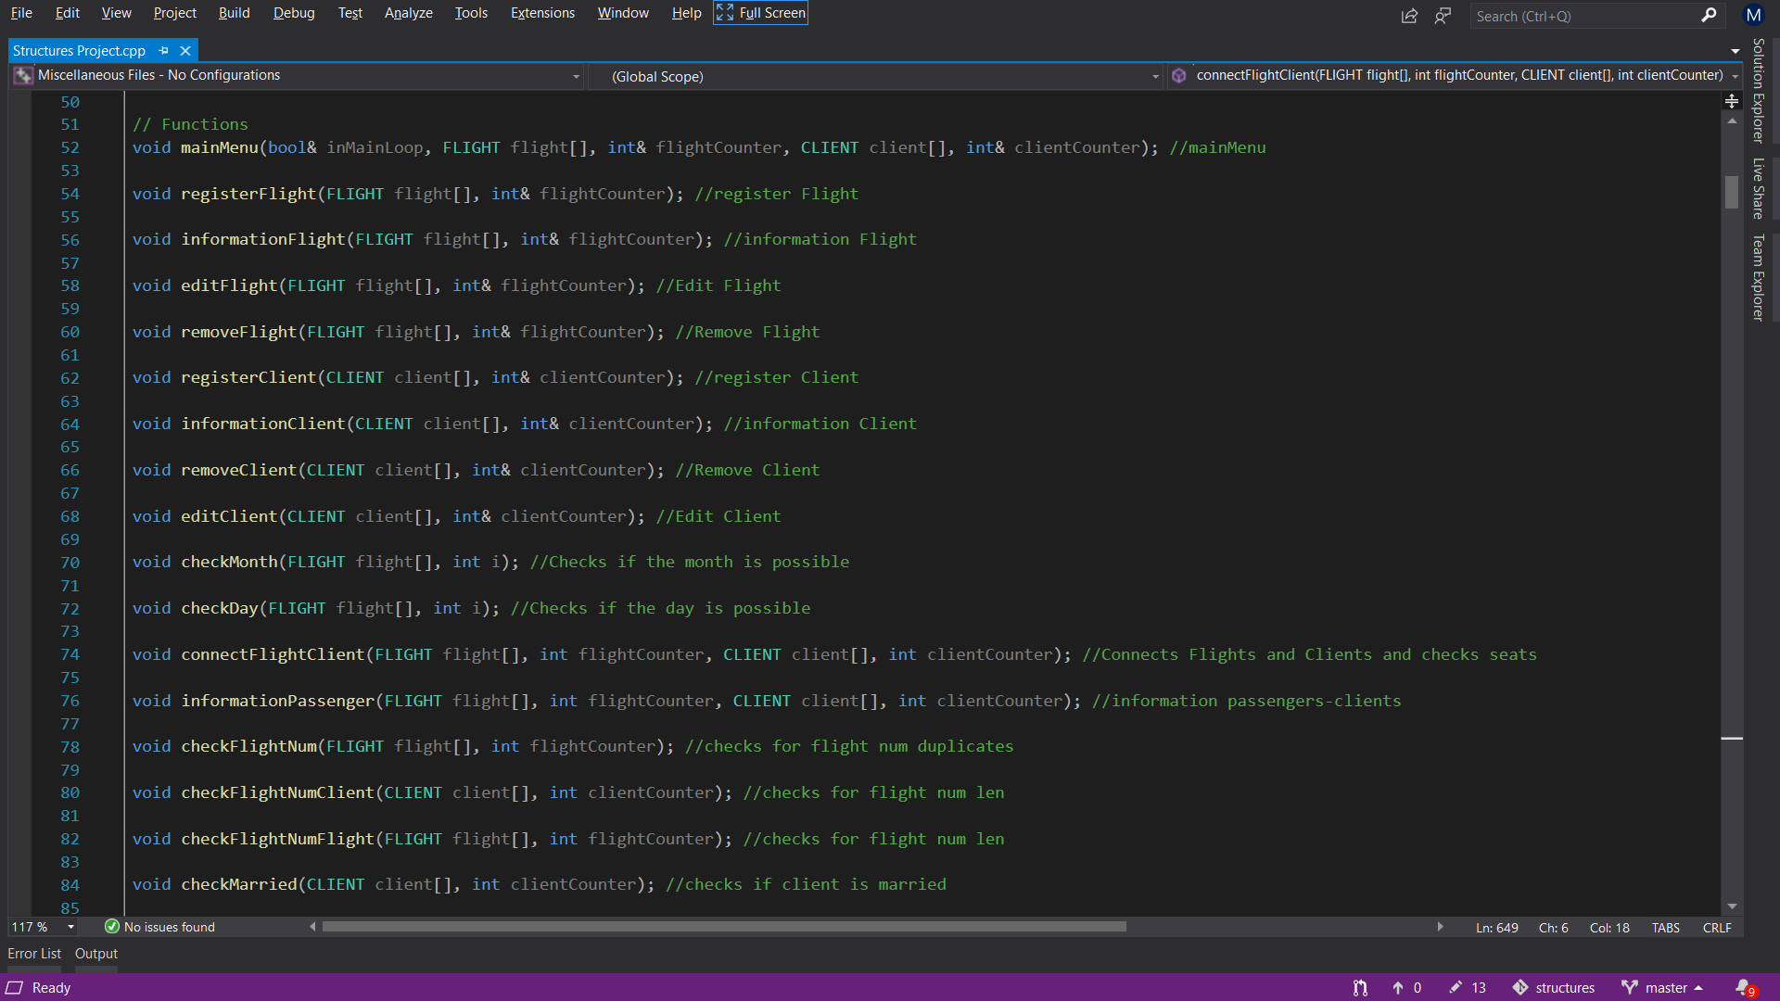
Different functions
Some of the functions included in Flights and Passengers. Registering, editing & removing a flights or clients including day, month, flight num and more check functions to ensure that everything works fine.

Slide 8
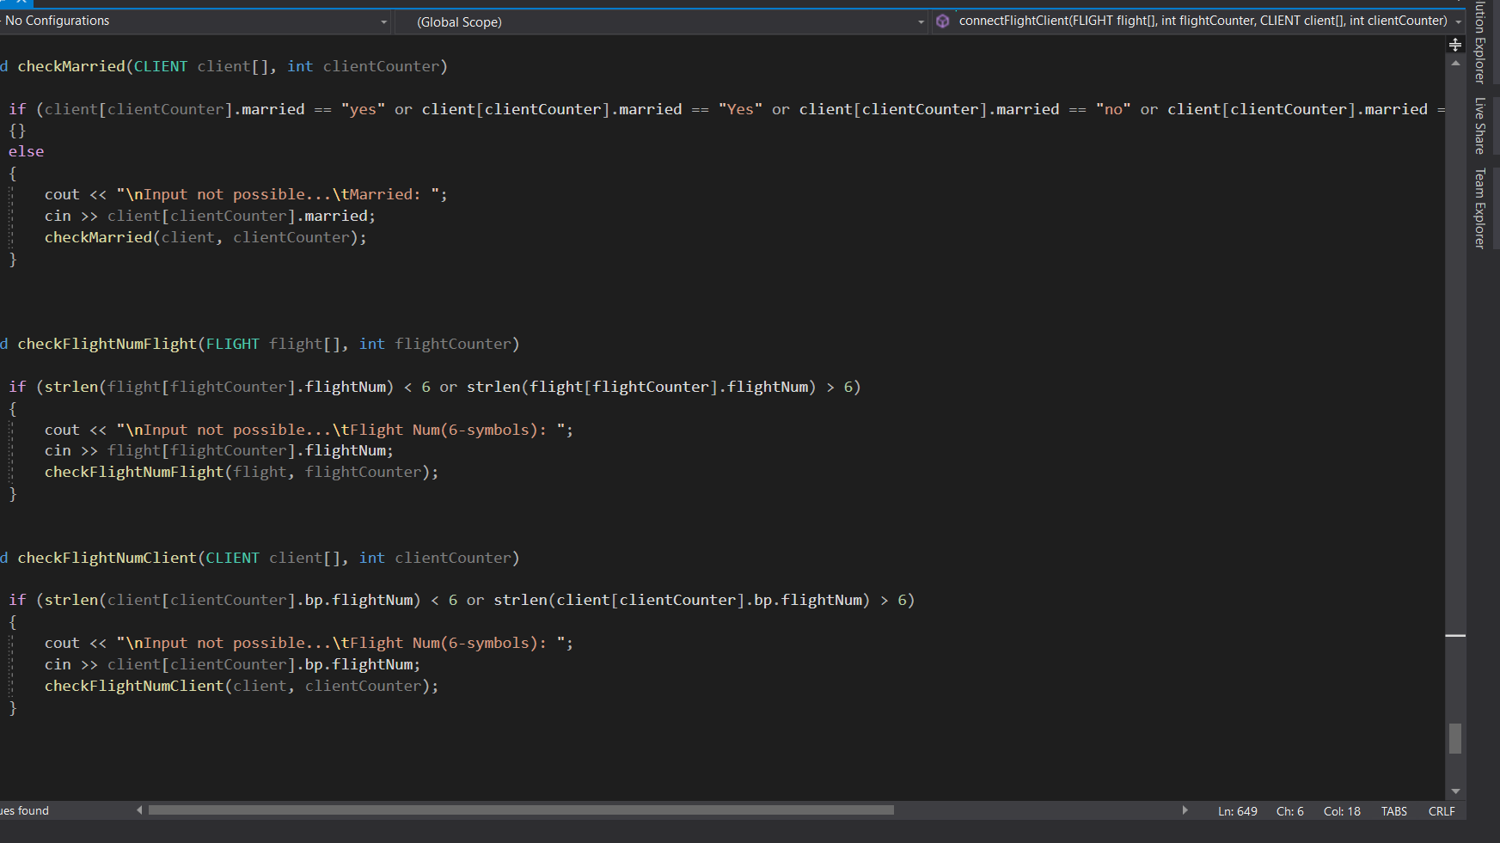
Check functions
Some of the check functions making sure the information is valid.

Slide 9
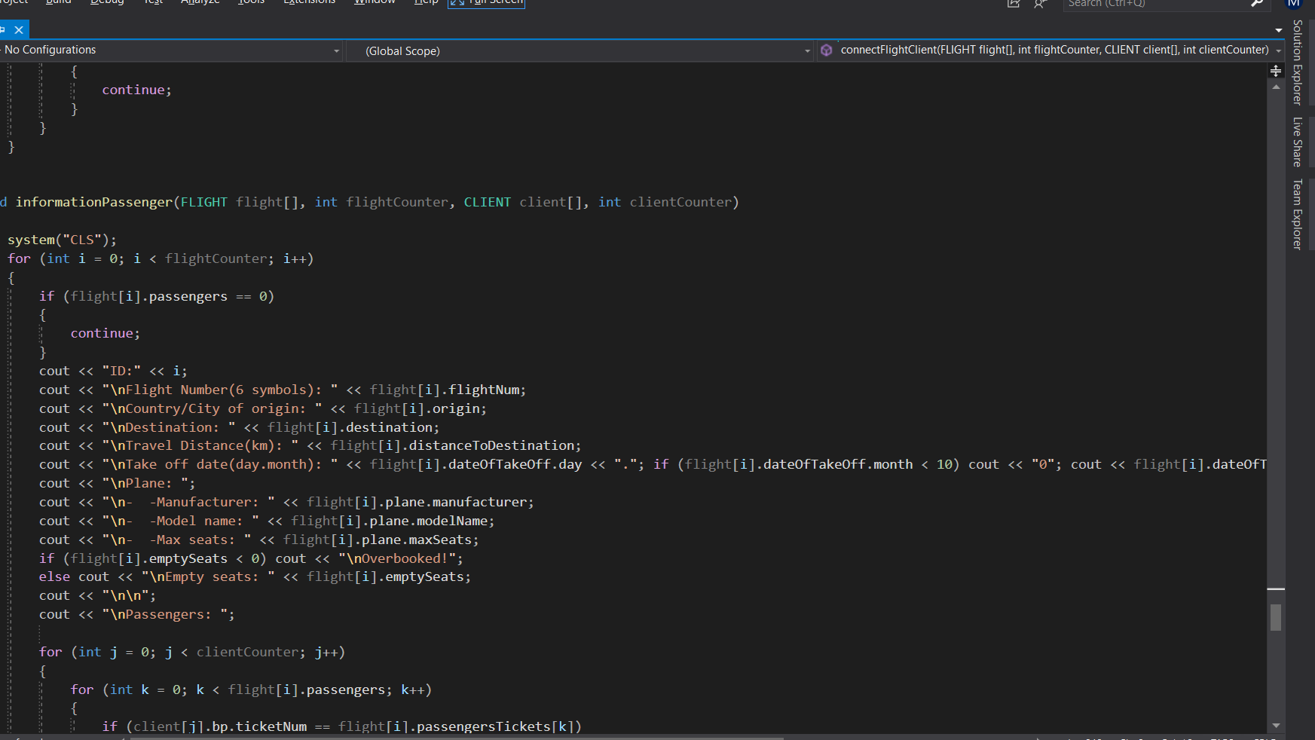
Flight informatioon
Flight information in the code

Slide 10
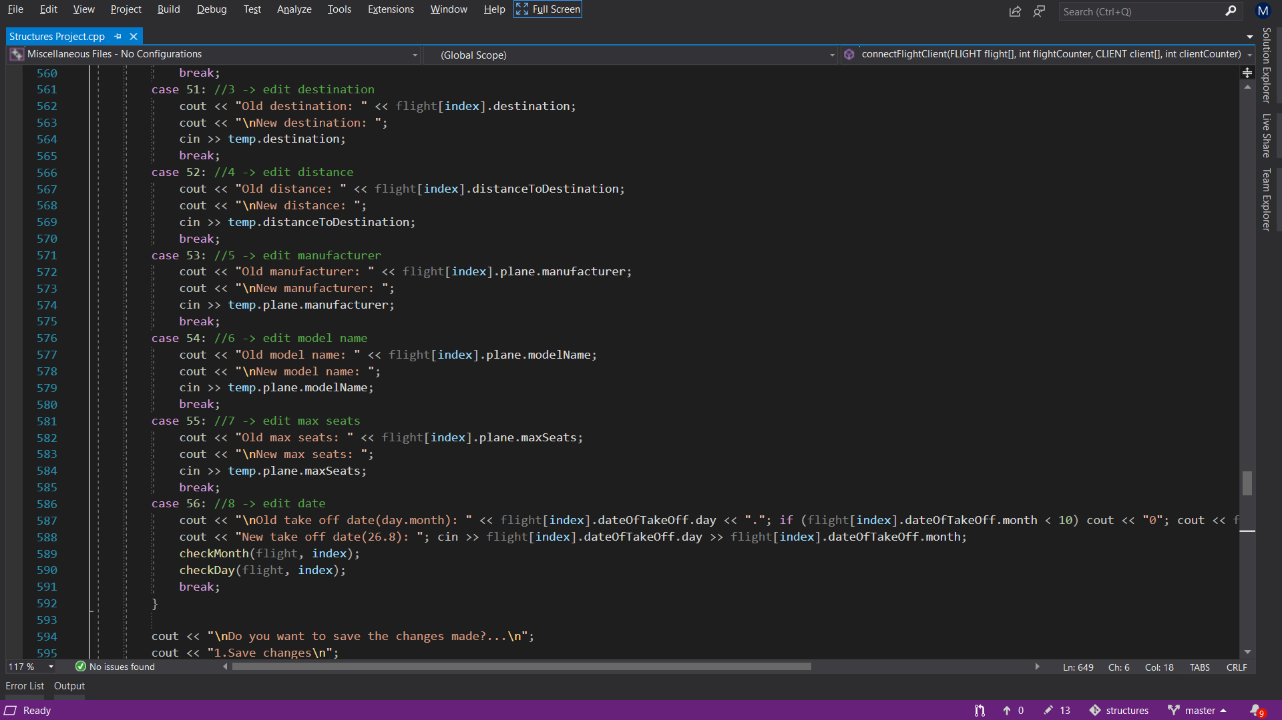
Editing flight and plane information
Editing flight and plane information using switch case.

Slide 11
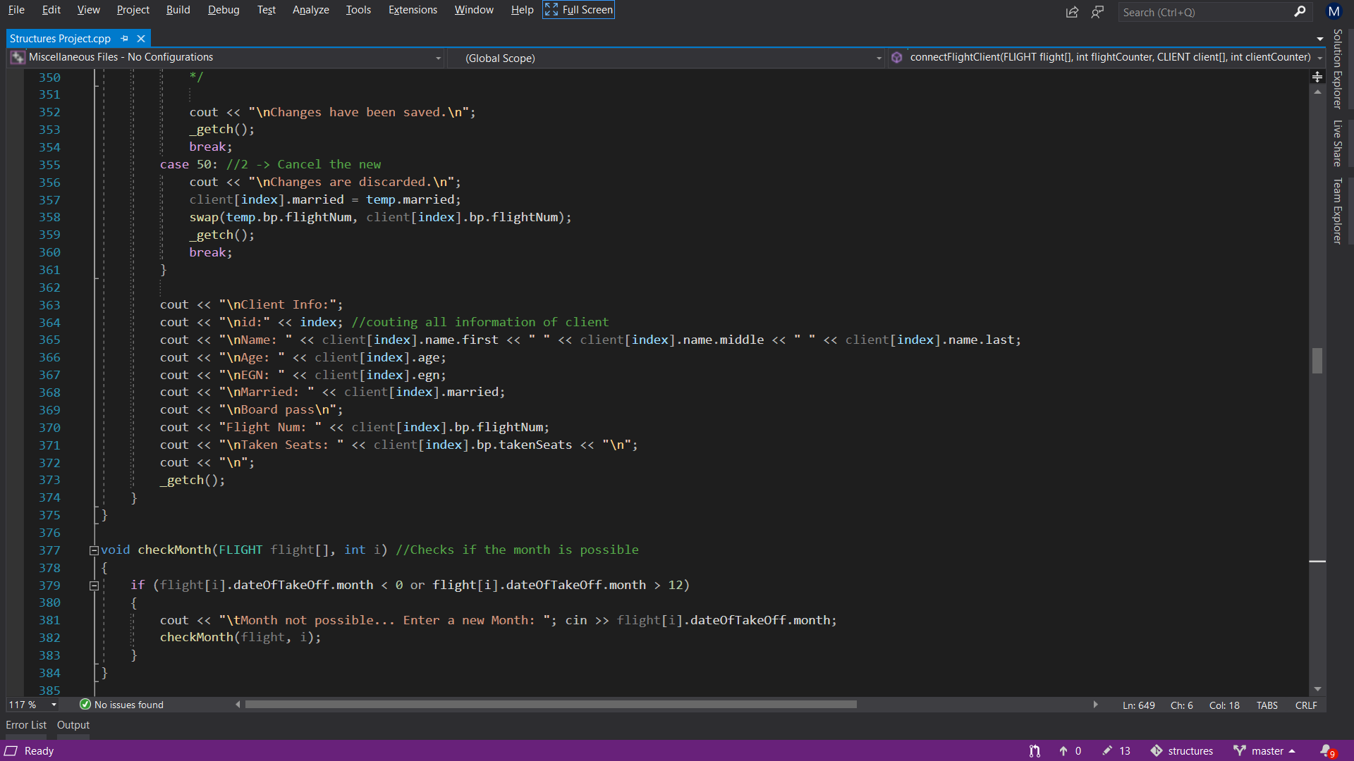
Client information
Registering a new client requires providing the displayed information

Slide 12
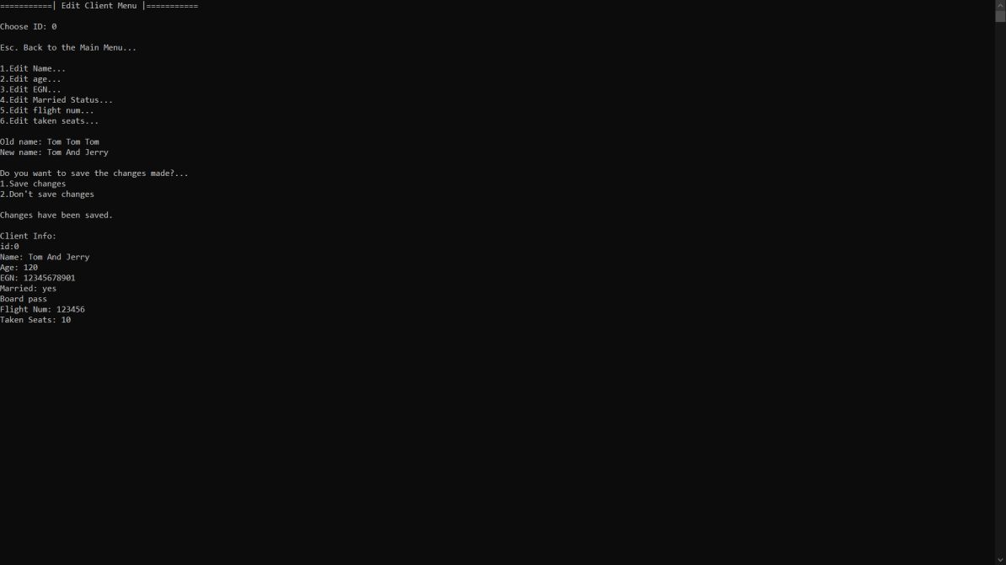
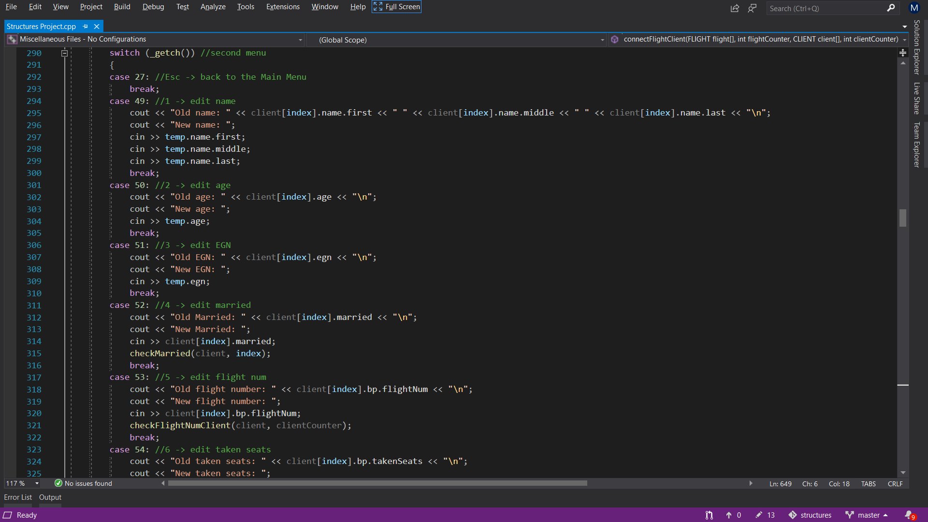
Editing client info

Slide 13
Thank you for the attention
Martin Sevov
Boris Kanev
Hristo Hristov

